Slide 1

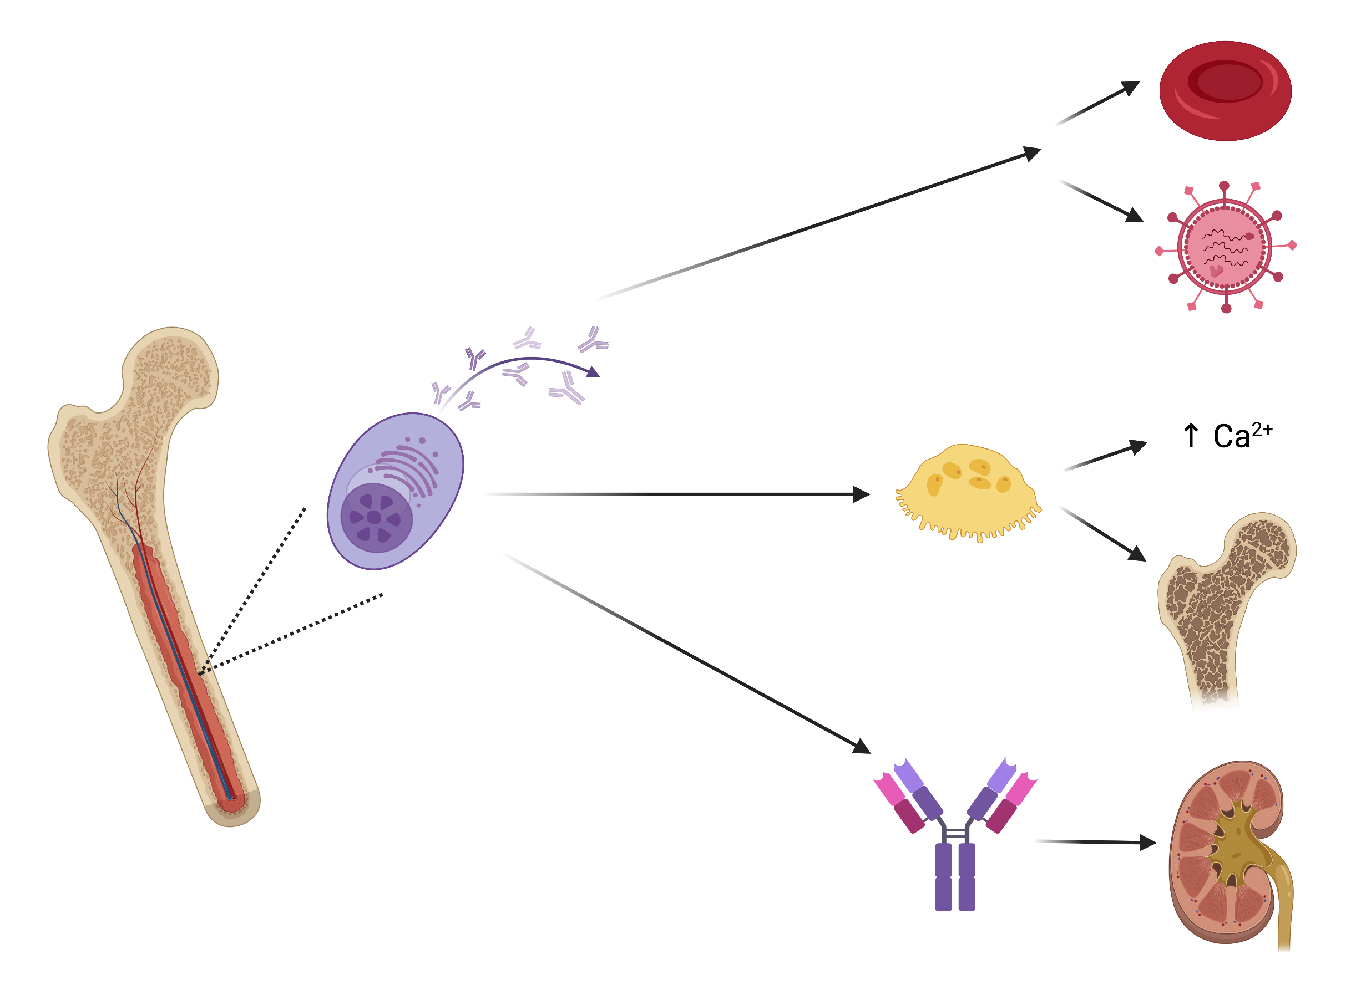
Pathogenesis
Plasma Cell Dyscrasias
Testing
Differential
Prognosis
Treatment
Cases
Notes:
plasma cell disorders are a large group of disorders that includes multiple myeloma (MM), monoclonal gammopathy of undetermined significance (MGUS), smoldering multiple myeloma (SMM), solitary plasmacytoma, Waldenström’s macroglobulinemia, primary amyloidosis (AL), heavy chain disease, POEMS syndrome, type I and II cryoglobulinemia. For this talk, we will just focus on MGUS, SMM, and MM.

Slide 2
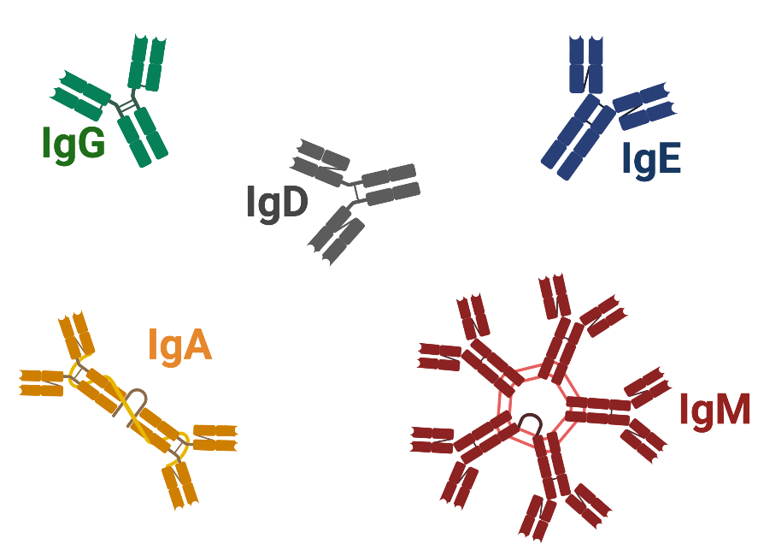

Pathogenesis - Basics
Pathogenesis
Basics
Pathology
Plasma cell function
Testing
Differential
Lymphoid lineage
Prognosis
Treatment
Cases
Immunoglobulin structure
Light Chain
(kappa or lambda in origin)
Heavy Chain
Notes:
Lymphoid progenitor cells differentiate into B cells which further differentiate into plasma cells once an antigen has been presented.
Plasma cells can make IgG, IgM, IgD, IgA, and IgE.
Each immunoglobulin is comprised of a heavy chain and a light chain.
Each light chain is either kappa or lambda in origin and in the absence of disease there is a relative balance of kappa and lambda light chains.
A “clonal” expansion” will have an abnormally high proportion of either kappa or lambda. An M protein (also called a paraprotein, monoclonal protein, or M component) is a monoclonal immunoglobulin secreted by an abnormally expanded clone of plasma cells in an amount that is above the polyclonal immunoglobulin background.

Slide 3
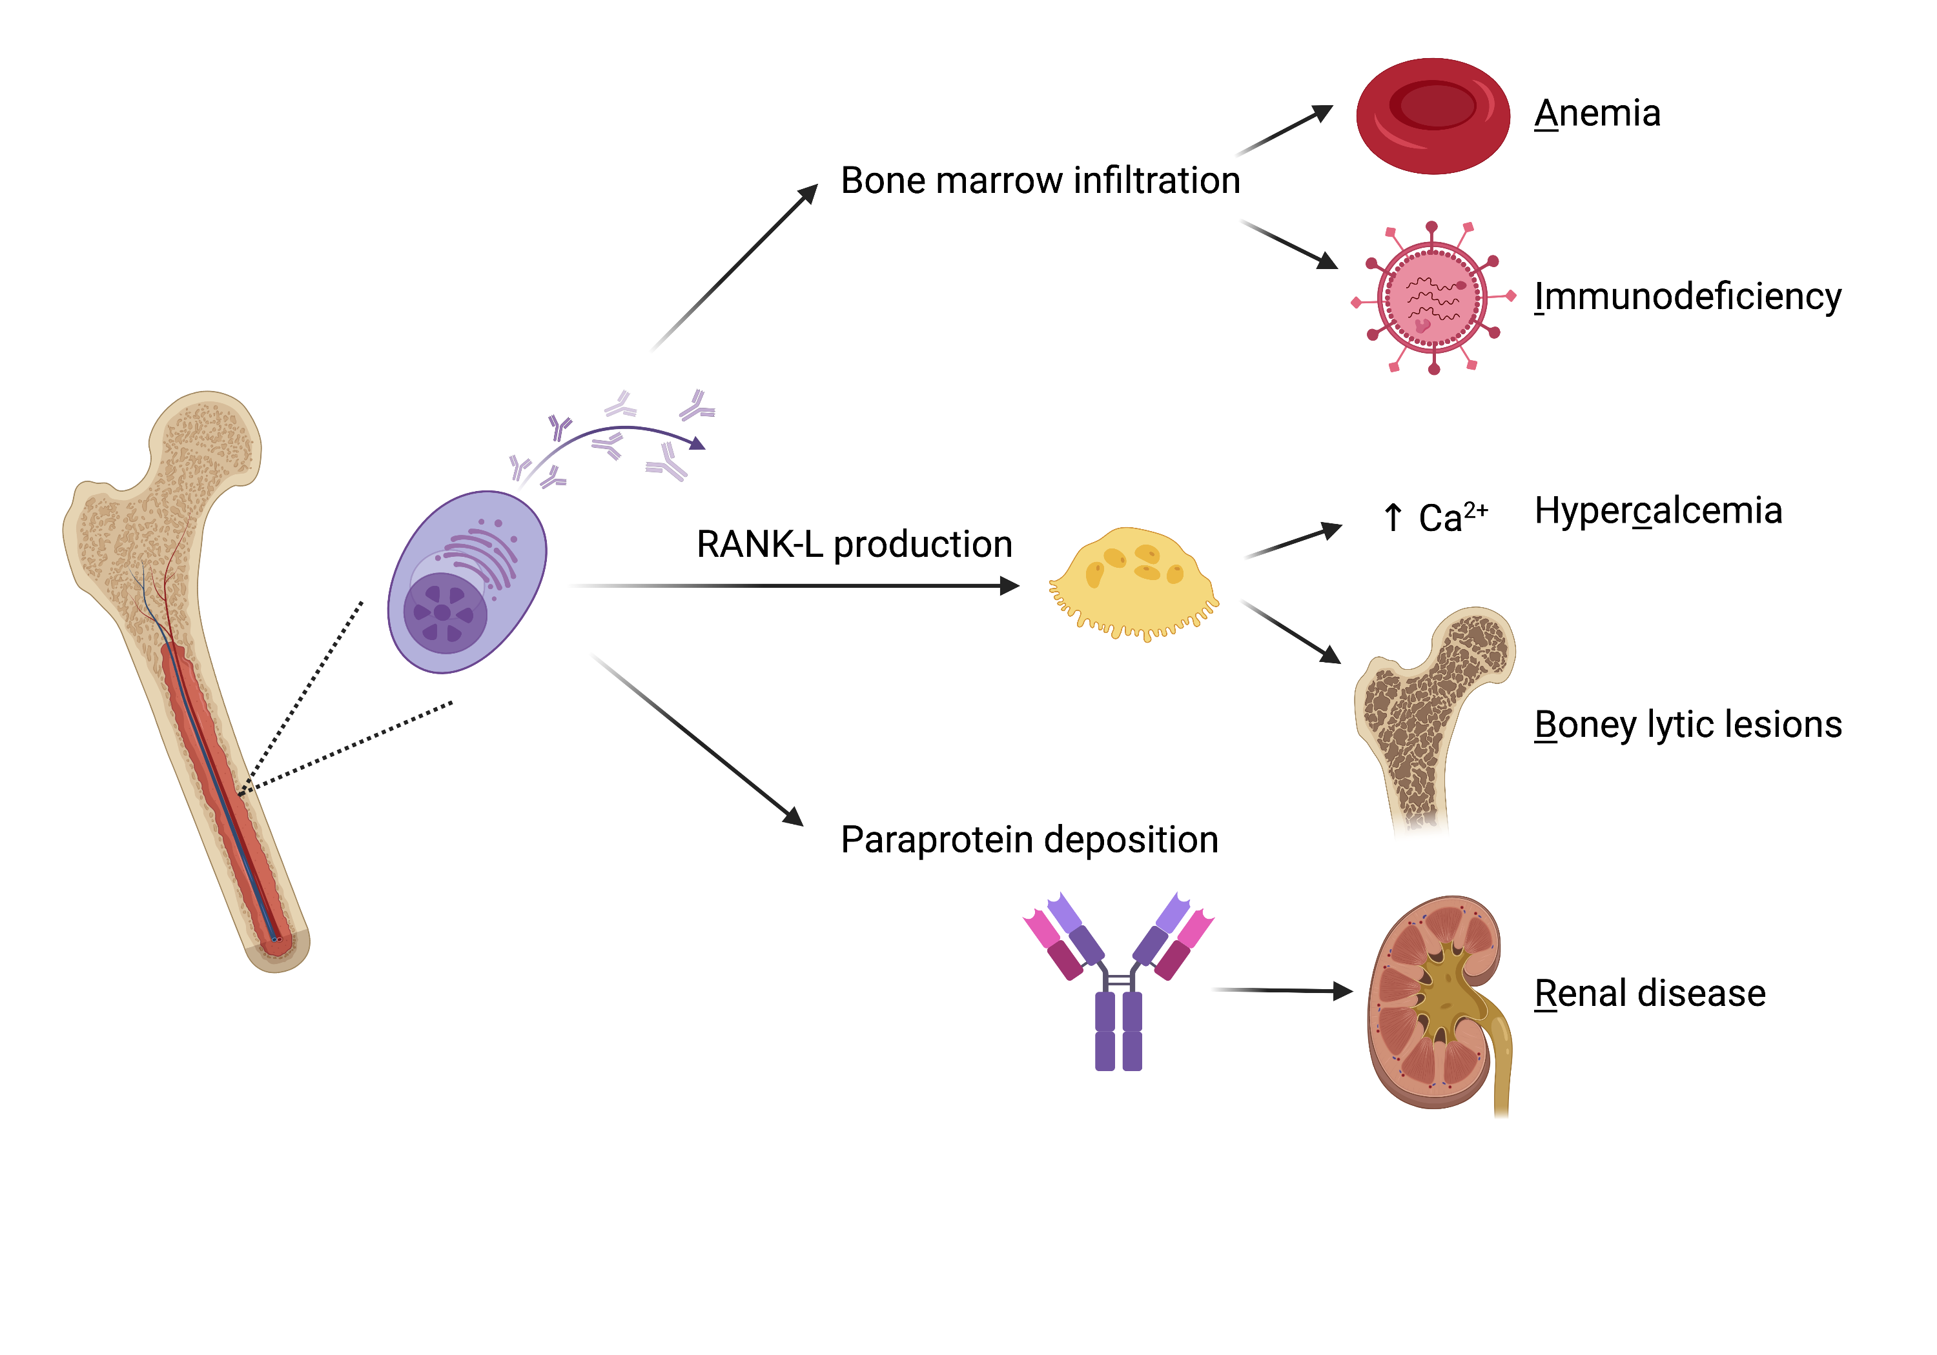


Pathogenesis - Pathology
Pathogenesis
Anemia
Basics
Bone marrow infiltration
Bone marrow infiltration
Pathology
Immunodeficiency
Testing
HyperCalcemia
Differential
RANK-L production
Prognosis
Osteoclast activation
Boney lytic lesions
Treatment
Cases
Paraprotein production
Renal disease
Paraprotein- related injury
C R A B I
Notes:
M proteins wreak havoc and cause the clinical findings we see in plasma cell dyscrasias.
What clinical findings are a result of bone marrow infiltration?
This leads to anemia and, what many don’t think of, profound immunocompromise
What clinical findings are a result of RANK-L production.
Increased RANK-L production and activation as well as direct activation of osteoclasts leads to hypercalcemia and osteolytic bone lesions and fracture.
Ask your learners to guess what clinical findings are a result of paraprotein (M protein)-related injury.
This leads to renal disease, with diverse pathology. In myeloma, this is most commonly cast nephropathy with an acute reduction in GFR. In other conditions like AL amyloid, it is often associated with nephrotic syndrome. In POEMs and Waldenström’s, this leads to neuropathy, but this is rare in MM.
If you suspect a plasma cell dyscrasia, what testing will you order?

Slide 4
Testing – Serum Protein Electrophoresis
Pathogenesis
Abnormal SPEP
Testing
Normal SPEP
Abnormal SPEP
M-Spike
SPEP
UPEP
FLC
Albumin
Alpha₁
Alpha₂
Beta
Gamma
Albumin
Alpha₁
Alpha₂
Beta
Gamma
Differential
Example SPEP
Example Immunofixation
Example SPEP
Example Immunofixation
Prognosis
 | Result (g/dL) | Reference Range (g/dL)
Albumin | 4.2 | 3.6 -5.4
Alpha₁ globulin | 0.3 | 0.1-0.3
Alpha₂ globulin | 0.3 | 0.5-0.3
Beta globulin | 1 | 0.5-1
Gamma globulin | 4.5 (H) | 0.5-1.4
SPEP
“There is an IgG Kappa restricted M-protein “
IgG
Treatment
IgA
IgM
Cases
Kappa
Lambda
“The monoclonal protein measures 3.2 g/dL“
SPEP
Sensitivity
Sensitivity
100%
50%
60%
70%
80%
90%
Notes:
A serum protein electrophoresis is the standard screening method for the detection of multiple myeloma.
It involves using electrophoresis to separate out the total protein by charge. It tells you the SIZE (serum concentration) of each protein.
Alpha1 includes HDL and alpha1 antitrypsin
Alpha 2 includes haptoglobin
Beta includes transferrin and C3
Gamma is the globulin region
Serum immunofixation, which is more sensitive than SPEP and also determines the heavy and light chain type of the monoclonal protein (i.e. IgG vs IgA).
However, unlike SPEP, immunofixation does not give an estimate of the size of the M protein (i.e., its serum concentration).
Should be done in conjunction with electrophoresis. You can also have a false positive with polyclonal elevation in IgG I things like infection.
Thus, it is always important to combine this test with a test for clonality.
SPEP with immunofixation has 80% sensitivity to detect plasma cell dyscrasias

Slide 5
Testing – Urine Protein Electrophoresis
Pathogenesis
Testing
Obtained from 24 h urine sample
SPEP
M-Spike
SPEP
UPEP
IgG
IgA
FLC
IgM
Kappa
Differential
Lambda
Albumin
Alpha₁
Alpha₂
Beta
Gamma
Prognosis
Why obtain a UPEP?
Why obtain a UPEP?
Treatment
UPEP improves sensitivity of SPEP from 80% to ~ 95%
Cases
SPEP
Sensitivity
100%
50%
60%
70%
80%
90%
SPEP + UPEP
Notes:
Traditionally, urine protein electrophoresis (UPEP) with urine immunofixation was used to increase the sensitivity of testing.
This test detects free light chains (so called “Bence Jones” proteins) that are small enough to pass through the glomeruli, into the urine.
Remember that urine protein on a dipstick is just albumin, so will miss Bence Jones proteins.
Combined, SPEP + UPEP increases the sensitivity to 95%.
However, this test must be collected on using a 24-hour urine collection; thus, there is a newer method used to screen for plasma cell dyscrasias.

Slide 6

Testing – Free Light Chains
Pathogenesis
Testing
Measures $\frac{κ }{λ}$
Normally produced in ~ equal amounts
Light Chain
↓clearance of all light chains
(κ or λ)
SPEP
Normal
Normal
κ disease
κ disease
λ disease
λ disease
ESRD
ESRD
MM
MM
Heavy Chain
UPEP
0.26-1.65
>1.65
<0.26
0.33-3.0
>100 or <0.01
FLC
λ disease
Normal
κ disease
MM
MM
Differential
0.01
0.25
0.5
1
3
5
100
λ disease
ESRD
κ disease
Prognosis
Why obtain FLC?
Why obtain FLC?
Treatment
1. Up to 16% have “light chain” only disease
Cases
2. FLC (in conjunction with SPEP) ↑ sensitivity and can replace UPEP
SPEP
SPEP + FLC
Sensitivity
100%
50%
60%
70%
80%
90%
SPEP + UPEP
Notes:
Kappa Lambda free light chain assay is a newer method, which can replace the time-consuming UPEP. This test measures the ratio of kappa to lamba light chains in the serum.
In normal circumstances, the ratio of kappa to lambda light chains is roughly equal and a normal ratio is 0.26-1.65.
A ratio > than 1.65 suggests and kappa clone.
A ratio <0.26 suggests a gamma clone.
However, renal disease alone may elevate ratio to 3. You should have high suspicion of plasma cell dyscrasia when ratio > 4 or < .25.
A ratio >100 or <0.01 is diagnostic of MM.
Up to 16% of MM only have light chain disease which is not well captured on SPEP.

Slide 7


Differential Diagnosis
Pathogenesis
Testing
MGUS
MGUS
Smoldering Myeloma
Smoldering Myeloma
Multiple Myeloma
Multiple Myeloma
Differential
<3 g/dL
≥3 g/dL
≥3 g/dL*
Prognosis
M protein
<500 mg/24 h
≥500 mg/24 h
≥500 mg/24 h
Treatment
% clonal plasma cells (bone marrow)
≥10%
(≥60% is diagnostic)
Cases
<10%
10-60%
End organ damage
None
None
CRABI
Extramedullary plasmacytoma
FLC > 100mg/dl and FLC ratio >100 or < 0.01
>1 focal lesion on MRI
Other MM defining events
None
None
1%/y risk of progression to MM
10% risk of progression to MM in first 5 y
*Oligo-secretory and non-secretory MM subtypes will not meet M-protein criteria
Why should we care?
Notes:
We use the tests we described as well as bone marrow biopsy, the presence of end organ damage, and a few myeloma-defining events to differentiate between MGUS, Smoldering myeloma and multiple myeloma
MGUS - MGUS is defined as an M protein less than 3 grams/dL in serum and less than 500 mg/24-hour period in urine as well as less than 10% clonal cells in the bone marrow and no signs of end organ damage (referring to your CRABI symptoms). Specifically: Calcium ≥ 11 mg/dL, SCr ≥ 2 mg/dL, or Hb < 12 g/dL not from another etiology, lytic lesions, pathologic fracture, or recurrent infections due to hypogammaglobulinemia.
Smoldering myeloma - Smoldering myeloma is when we can measure the M protein greater than or equal to 3 g/dL or greater than or equal to 500 mg/24-hour period or a bone marrow biopsy with 10-60% plasma cells, but still no CRABI symptoms.
Sometimes this requires a thorough radiographic evaluation to ensure lytic lesions aren’t missed. While whole body x-rays are easy to obtain, they may miss small lytic lesions. MRI is more sensitive but may be challenging to obtain.
PET/CT is the most sensitive modality and currently the gold standard for evaluation.
It is important to diagnose MGUS and MM because the risk of progression with MGUS is 1% per year and the risk of progression with smoldering myeloma is 10% for first 5 years and 5% per year thereafter.
MM - MM is diagnosed when the M protein is greater than or equal to 3 g/dL or greater than or equal to 500 mg/24-hour period or a bone marrow biopsy with 10-60% plasma cells AND there is presence of end organ damage or a MM defining events. These events were established by the International Myeloma Working Group as marrow involvement >60%, an extramedullary plasmacytoma, an elevation in FLC greater than 100mg/dL with FLC ratio >100 or <0.1, >1 focal lesion on MRI
1. Rajkumar SV, Dimopoulos MA, Palumbo A, et al. International Myeloma Working Group updated criteria for the diagnosis of multiple myeloma. Lancet Oncol. 2014;15(12):e538-548.

Slide 8


Prognosis
Pathogenesis
R-ISS Criteria
Stage I
Stage I
Stage II
Stage II
Stage III
Testing
Stage III
Differential
β2- microglobulin
<3.5 mg/L
Not meeting criteria for R-ISS stage I or III
>5.5 mg/L
+
+
Prognosis
LDH
Normal
↑ LDH
Treatment
+
±
iFISH
Standard risk
High risk
del(17p), t(4;14), t(14;16)
Cases
+
Albumin
≥3.5 g/dL
Median Survival
82% survival at 5 years
83 months
43 months
Other prognostic factors?
Tumor factors
Proliferation rate
Plasma cell leukemia
Extramedullary disease
Patient factors
Age
Comorbidities
Renal function
ECOG (performance status)
Other prognostic factors?
Notes:
MM is a heterogenous disease with variable prognosis. We use the Revised International Staging System (R-ISS) to stratify patient’s risk.
Stage I is defined as serum beta2microglobulin < 3.5 mg/L, and normal LDH, and standard-risk chromosomal abnormalities by iFISH, and serum albumin ≥ 3.5 g/dl. This is your reminder to order a beta2microglobulin, LDH, and albumin as you’re calling the oncologist with a new MM diagnosis.
Palumbo A, et al. J Clin Oncol. 2015;33(26):2863-2869
del(17p), t(4;14), or t(14;16)

Slide 9
Natural History
Pathogenesis
Testing
Typically, 3 or 4 drug regimen:
Proteasome inhibitor
Immunomodulatory agent
Steroids
± monoclonal antibody
Induction
Induction
Differential
Prognosis
Subsequent relapses
Subsequent relapses
Relapse and Treatment Intensification
Relapse and Treatment Intensification
Treatment
Natural Hx
M-protein
Med Tox
Maintenance
De-escalation of treatment to 1-2 drugs
Maintenance
Comp
Cases
Eligibility:
Age < 65 (up to age 75)
ECOG < 3
No cirrhosis, severe HF
Renal disease is NOT a contraindication
autoSCT
autoSCT
Time

Slide 10


Complications of Therapies
Pathogenesis
Proteasome Inhibitors
Proteasome Inhibitors
Immuno-modulatory Agents
Immuno-modulatory Agents
Steroids
Steroids
Monoclonal Abs
Testing
Monoclonal Abs
Differential
Bortezomib (Velcade)
Carfilzomib (Kyprolis)
Lenalidomide (Revlimid)
Pomalidomide (Pomalyst)
Daratumumab
Isatuximab
Elotuzumab
Dexamethasone
Prognosis
Myelo-suppression
Treatment
↓ PMNs/ plts
↓ PMNs/RBCs/plts
Natural Hx
GI irritation
Consider PPI
Med Tox
Infections
Comp
Shingles ppx
Consider PJP ppx
Neuropathy
Velcade
Cardiovascular
Carfilzomib
VTE/arterial thrombosis
Asa vs. anticoag ppx
Hyperglycemia
Bone loss
Ca-Vit D or bisphosphonates
Acute infusion reaction
Cases
Other
Side Effects
Notes:
Treatment – Med Tox
The most common medications used to treat MM are proteasome inhibitors (such as Bortezomib/Velcade and Carfilzomib/Kyprolis), immunomodulatory agents (such as Lenalidomide/Revlimid and Pomalidomide/Pomalyst), steroids, and monoclonal antibodies [Daratumumab or Isatuximab (anti-CD38) and Elotuzumab (anti-SLAMF7)].
Proteasome inhibitors: The most common side effects of the proteasome inhibitors are myelosuppression, GI irritation, and profound neuropathy. It’s important to note that this medication puts you at high risk for herpes zoster reactivation and patients should be on continuous shingles prophylaxis.
Immunomodulatory agents: The most common side effects of the immunomodulatory agents are also myelosuppression, GI irritation, and infections. These patients are also at high risk for VTE and arterial thrombosis and should take prophylaxis using an aspirin or full anticoagulation.
Steroids: We are more familiar with the side effects of steroids, but it’s important to note these patients may remain on high dose steroids for extended periods of time and to consider other GI, infectious, and bone health prophylaxis.
Monoclonal Abs: There are new treatments for plasma cell dyscrasias emerging every year. Two of the most common for MM (daratumumab, isatuximab, and elotuzumab) have similar side effects of myelosuppression, GI irritation, and immunosuppression. Patients may also experience acute infusion reactions

Slide 11



Treatment of Complications
Pathogenesis
Testing
Anemia
Evaluate and treat for other causes
Anemia
Differential
Prognosis
IVIg if IgG is low (<500) + recurrent infections
Immunodeficiency
Immunodeficiency
Treatment
Natural Hx
HyperCalcemia
Bisphosphonates
Acute hospitalization
HyperCalcemia
Med Tox
Ca and vit D (if Ca normal)
Systemic therapy + bisphosphonates
Consider radiation
Avoid surgery unless emergency
Comp
Boney lytic lesions
Boney lytic lesions
Cases
IVF to target high UOP
Consider biopsy
Urgent systemic therapy
Renal disease
Renal disease

Slide 12
Pathogenesis
Case 1
Case 2a
55 year-old recently admitted for AKI and proteinuria presents to clinic for hospital follow-up. AKI resolved on discharge. SPEP and FLC ordered for proteinuria shows:
64 year-old presents for follow-up of abnormal labs. SPEP, immunofixation, and K/L FLC assay results show:
Testing
Test | Result (g/dL) | Reference (g/dL)
Albumin | 4.2 | 3.6-5.4
Alpha1 globulin | 0.3 | 0.1-0.3
Alpha2 globulin | 0.6 | 0.5-0.3
Beta globulin | 1 | 0.5-1
Gamma globulin | 4.5 (H) | 0.5-1.4
Differential
Test | Result (g/dL) | Reference (g/dL)
Albumin | 4.2 | 3.6-5.4
Alpha1 globulin | 0.3 | 0.1-0.3
Alpha2 globulin | 0.6 | 0.5-0.3
Beta globulin | 1 | 0.5-1
Gamma globulin | 3 (H) | 0.5-1.4
Prognosis
The monoclonal protein measures 3.5 g/dL
IFX: “IgA lambda monoclonal protein”
Kappa: 1 Lambda: 5 K/L Ratio: .2
Labs: Hgb 14, Cr 1.0, calcium of 9.5
The monoclonal protein measures 3.5 g/dL
IFX: “IgA lambda monoclonal protein”
Kappa: 1 Lambda: 5 K/L Ratio: .2
Labs: Hgb 14, Cr 1.0, calcium of 9.5
PET/CT: no lytic lesions
Bone marrow biopsy: 12% involvement.
Treatment
The monoclonal protein measures 2 g/dL
IFX: “IgG kappa monoclonal protein identified”
Kappa: 6.3 Lambda:2.1 K/L Ratio: 3
12% involvement.
The monoclonal protein measures 2 g/dL
IFX: “IgG kappa monoclonal protein identified”
Kappa: 6.3 Lambda:2.1 K/L Ratio: 3
Cases
How would you interpret these results?
What plasma cell dyscrasia does this patient have?
1 & 2a
There is an M-spike that measures <3 g/dL. FLC ratio is elevated.
Smoldering MM. M-spike > 3 g/dL and > 10% bone marrow involvement but no end organ damage.
2b & 2c
What other tests would you order to aid in diagnosis?
What is this patient’s risk of progression every year?
CBC, calcium, creatinine, imaging, bone marrow biopsy.
10% for first 5 years and 5% per year for next 5 years
…Labs: Hgb 13. Calcium 9. Cr stable at 1.
PET-CT shows no lytic lesions. Bone marrow biopsy shows 5% plasma clonal cells.
What lab monitoring should this patient have?
Serial SPEP, IFX, UPEP, serum FLC assay, CBC, Ca, and Cr.
Repeat at frequent intervals (~3 months initially), which may reduce over time if disease stable.
What is the diagnosis?
MGUS

Slide 13
Pathogenesis
Case 2b
Case 2c
One year later, the patient presents to the ED with acute onset back pain. Lumbar XR shows two vertebral fractures and several other boney lucencies. Labs shows Cr of 2.1 (baseline 1.1), Ca is 10.5.
After treatment with RVd, they went into remission and was maintained on lenalidomide for 1 year. They represent with AKI with Cr up to 2.3. Subsequent testing revealed an increase in IgA lambda monoclonal spike. Kidney biopsy shows tubular deposition of light chain casts.
Testing
Differential
What plasma cell dyscrasia does this patient have?
How would you treat the AKI?
Prognosis
IgA lambda multiple myeloma. They now have signs of end-organ damage (boney lesions).
This is myeloma kidney. Aggressive IVF (if no contraindication) to target ~3 L of UOP/day to prevent further cast deposition in tubules. Need to start urgent salvage systemic therapy
Treatment
What studies would you order next?
Cases
Repeat SPEP, UPEP, serum FLC. Bone marrow biopsy. Albumin, beta-2 microglobulin, LDH are all helpful in staging and prognosis.
…They received second line therapy and subsequently underwent an autoSCT. They remained in remission for a few years until they represented to the ED with fevers, cough, hypoxia. A CT shows bilateral ground glass opacities.
1 & 2a
…A bone marrow biopsy, which shows no high-risk features. R-ISS stage is 1. They are started on RVd (lenalidomide, bortezomib and dexamethasone)
What are the potential sources of this patient’s presentation?
2b & 2c
Common causes of CAP (S. pneumo, COVID-19, viruses), Opportunistic pathogens (PJP, aspergillus, endemic fungi) and Nosocomial infections (Staph and Pseudomonas). It is rare, but in extremely advanced myeloma, the infiltrates could also be cancer.
What other supportive/prophylactic medications does this patient need?
Bisphosphonate
Acyclovir ppx when on bortezomib
ASA (or full anticoagulation) when on lenalidomide
PJP ppx, PPI, vitamin D and calcium if continuing steroids
What additional therapy can we offer this patient if they present with repeat infections?
IVIg is indicated for patients with MM and multiple infections.
Notes:
Repeat SPEP and K/L FLC . The heme/onc consult service asks you to order total IgG, IgA, IgM, a UPEP, beta2microglubulin, LDH and serum albumin.
NCCN guidelines

Slide 14
Newer Context — Updates Since 2023
Standing diagnostic framework (SPEP/IFX + serum FLC, CRABI, MGUS→SMM→MM thresholds) is unchanged. Updates since 2023 are in therapy and prognosis:
Front-line induction is now a QUADRUPLET: add an anti-CD38 mAb (daratumumab) to VRd. D-VRd reduced progression/death ~60% vs VRd — PERSEUS, NEJM 2024; FDA-approved for transplant-eligible NDMM (Jul 2024); Isa-VRd approved transplant-ineligible (IMROZ, 2024).
R2-ISS (D’Agostino, JCO 2022) refines R-ISS by adding gain/amp 1q21 (+ LDH, del17p/t(4;14)) into a 4-tier additive score — better separates the large R-ISS stage II group.
High-risk smoldering myeloma: daratumumab monotherapy delayed progression (5-yr PFS 63% vs 41%) — AQUILA, NEJM 2024; supports earlier intervention vs active monitoring in select high-risk SMM.
Relapsed/refractory: BCMA-targeted classes now standard — CAR-T cilta-cel (CARTITUDE-4, FDA Apr 2024, ≥1 prior line) & ide-cel; bispecifics teclistamab (Oct 2022), elranatamab, talquetamab (GPRC5D).
Monitoring: mass spectrometry (MALDI-TOF) emerging as a more sensitive alternative to immunofixation (not yet routine).
All updates clinician/heme-onc–reviewed before teaching. Sources: PERSEUS NEJM 2024; D’Agostino JCO 2022; AQUILA NEJM 2024; FDA approvals 2022–2024.

Slide 15
Take-Home Points
MGUS, smoldering myeloma (SMM), and MM are a spectrum of clonal plasma-cell disorders; complications follow CRABI — hyperCalcemia, Renal dysfunction, Anemia, Boney lytic lesions, Immunodeficiency.
Screen with SPEP + serum immunofixation AND serum free light chains (FLC). FLC catches the ~16% of light-chain-only myeloma SPEP misses; SPEP+FLC sensitivity ~99% and replaces the 24-h UPEP.
Distinguish MGUS / SMM / MM by M-protein size, % clonal marrow plasma cells, and end-organ damage (CRABI) or a myeloma-defining biomarker (≥60% marrow, FLC ratio ≥100, >1 focal MRI lesion).
Progression risk: MGUS ~1%/yr; SMM ~10%/yr for the first 5 years. Order β2-microglobulin (mg/L), LDH, albumin, and FISH at diagnosis for R-ISS / R2-ISS staging.
Front-line therapy is now quadruplet (anti-CD38 mAb + VRd) ± autoSCT then maintenance; manage hypercalcemia, cast nephropathy (aggressive IVF, urgent systemic therapy), and infection/VTE prophylaxis.

Slide 16
Attribution & Optimization Changelog
Original lesson: “Plasma Cell Dyscrasias,” TeachIM.org (Published Jan 2023).
Authors: Meryl Colton MD MSc; Peter Forsberg MD. Section Editor: Christopher Geiger MD. Executive Editor: Yilin Zhang MD. University of Colorado.
https://teachim.org/teaching_material/plasma-cell-dyscrasias/
License: Creative Commons Attribution-NonCommercial 4.0 (CC BY-NC 4.0). Educational, non-commercial use only.
Optimization (2026-06-10) — surgical corrections, animations/graphics preserved:
• Slide 8 (R-ISS): β2-microglobulin units “g/dL” → “mg/L” (×2; β2M is reported in mg/L — lesson page uses mg/L); albumin g/dL left unchanged.
• Slide 8: R-ISS stage III median survival “42 months” → “43 months” (matches lesson page table & Palumbo, JCO 2015).
• Slides 9–10 (incl. notes): spelling “Proteosome” → “Proteasome”.
• Appended: this attribution slide, a take-home slide, and a 2023–2026 newer-context slide.
Human review: Slide 4 & case tables list Alpha-2 globulin reference range as “0.5-0.3” (reversed/implausible); intended value not stated, left unedited — confirm correct range. Medical content should be clinician-reviewed before teaching.

